Slide 3
LAC Poverty Rates
Poverty headcount ratio at $5.50 a day (2011 PPP)
GDP Per Capita (current US$)
Evolution of Poverty Rates and GDP Per Capita.
LAC GDP Per Capita

Slide 4
Under-5 mortality rate (per 1,000 live births)
Child mortality rates in LAC countries compared with the trajectory of Portugal since 1965.
Portugal

Slide 5
Under-5 mortality rate (per 1,000 live births)
Child mortality rates in LAC countries compared with the trajectory of Portugal since 1965.
45 years
30 years
Portugal

Slide 6
Under-5 mortality rate (per 1,000 live births)
Child mortality rates in selected Brazilian states compared with the trajectory of Brazil since 1975.

Slide 7
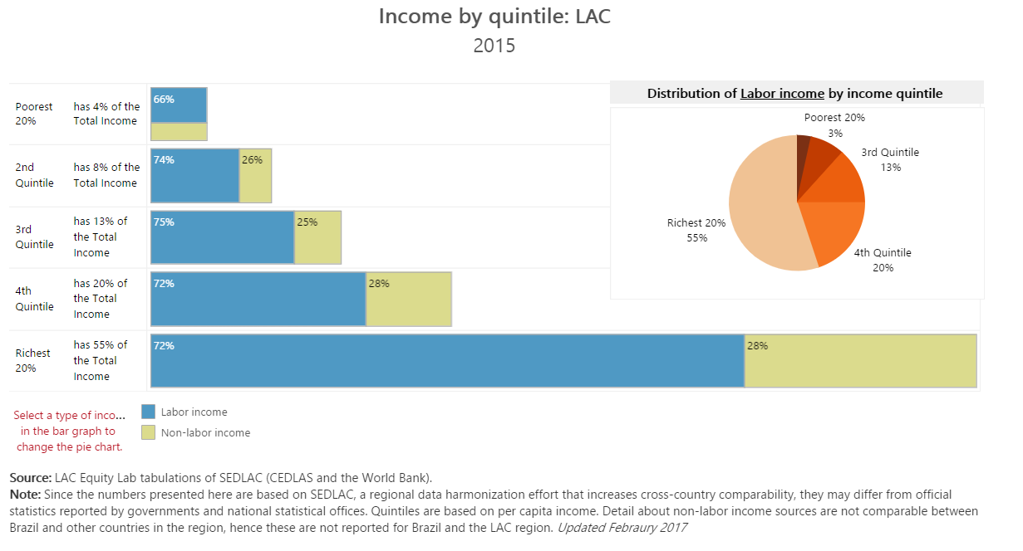
Growth is Highly Uneven:
55 percent of total income goes to the richest 20 percent

Slide 8
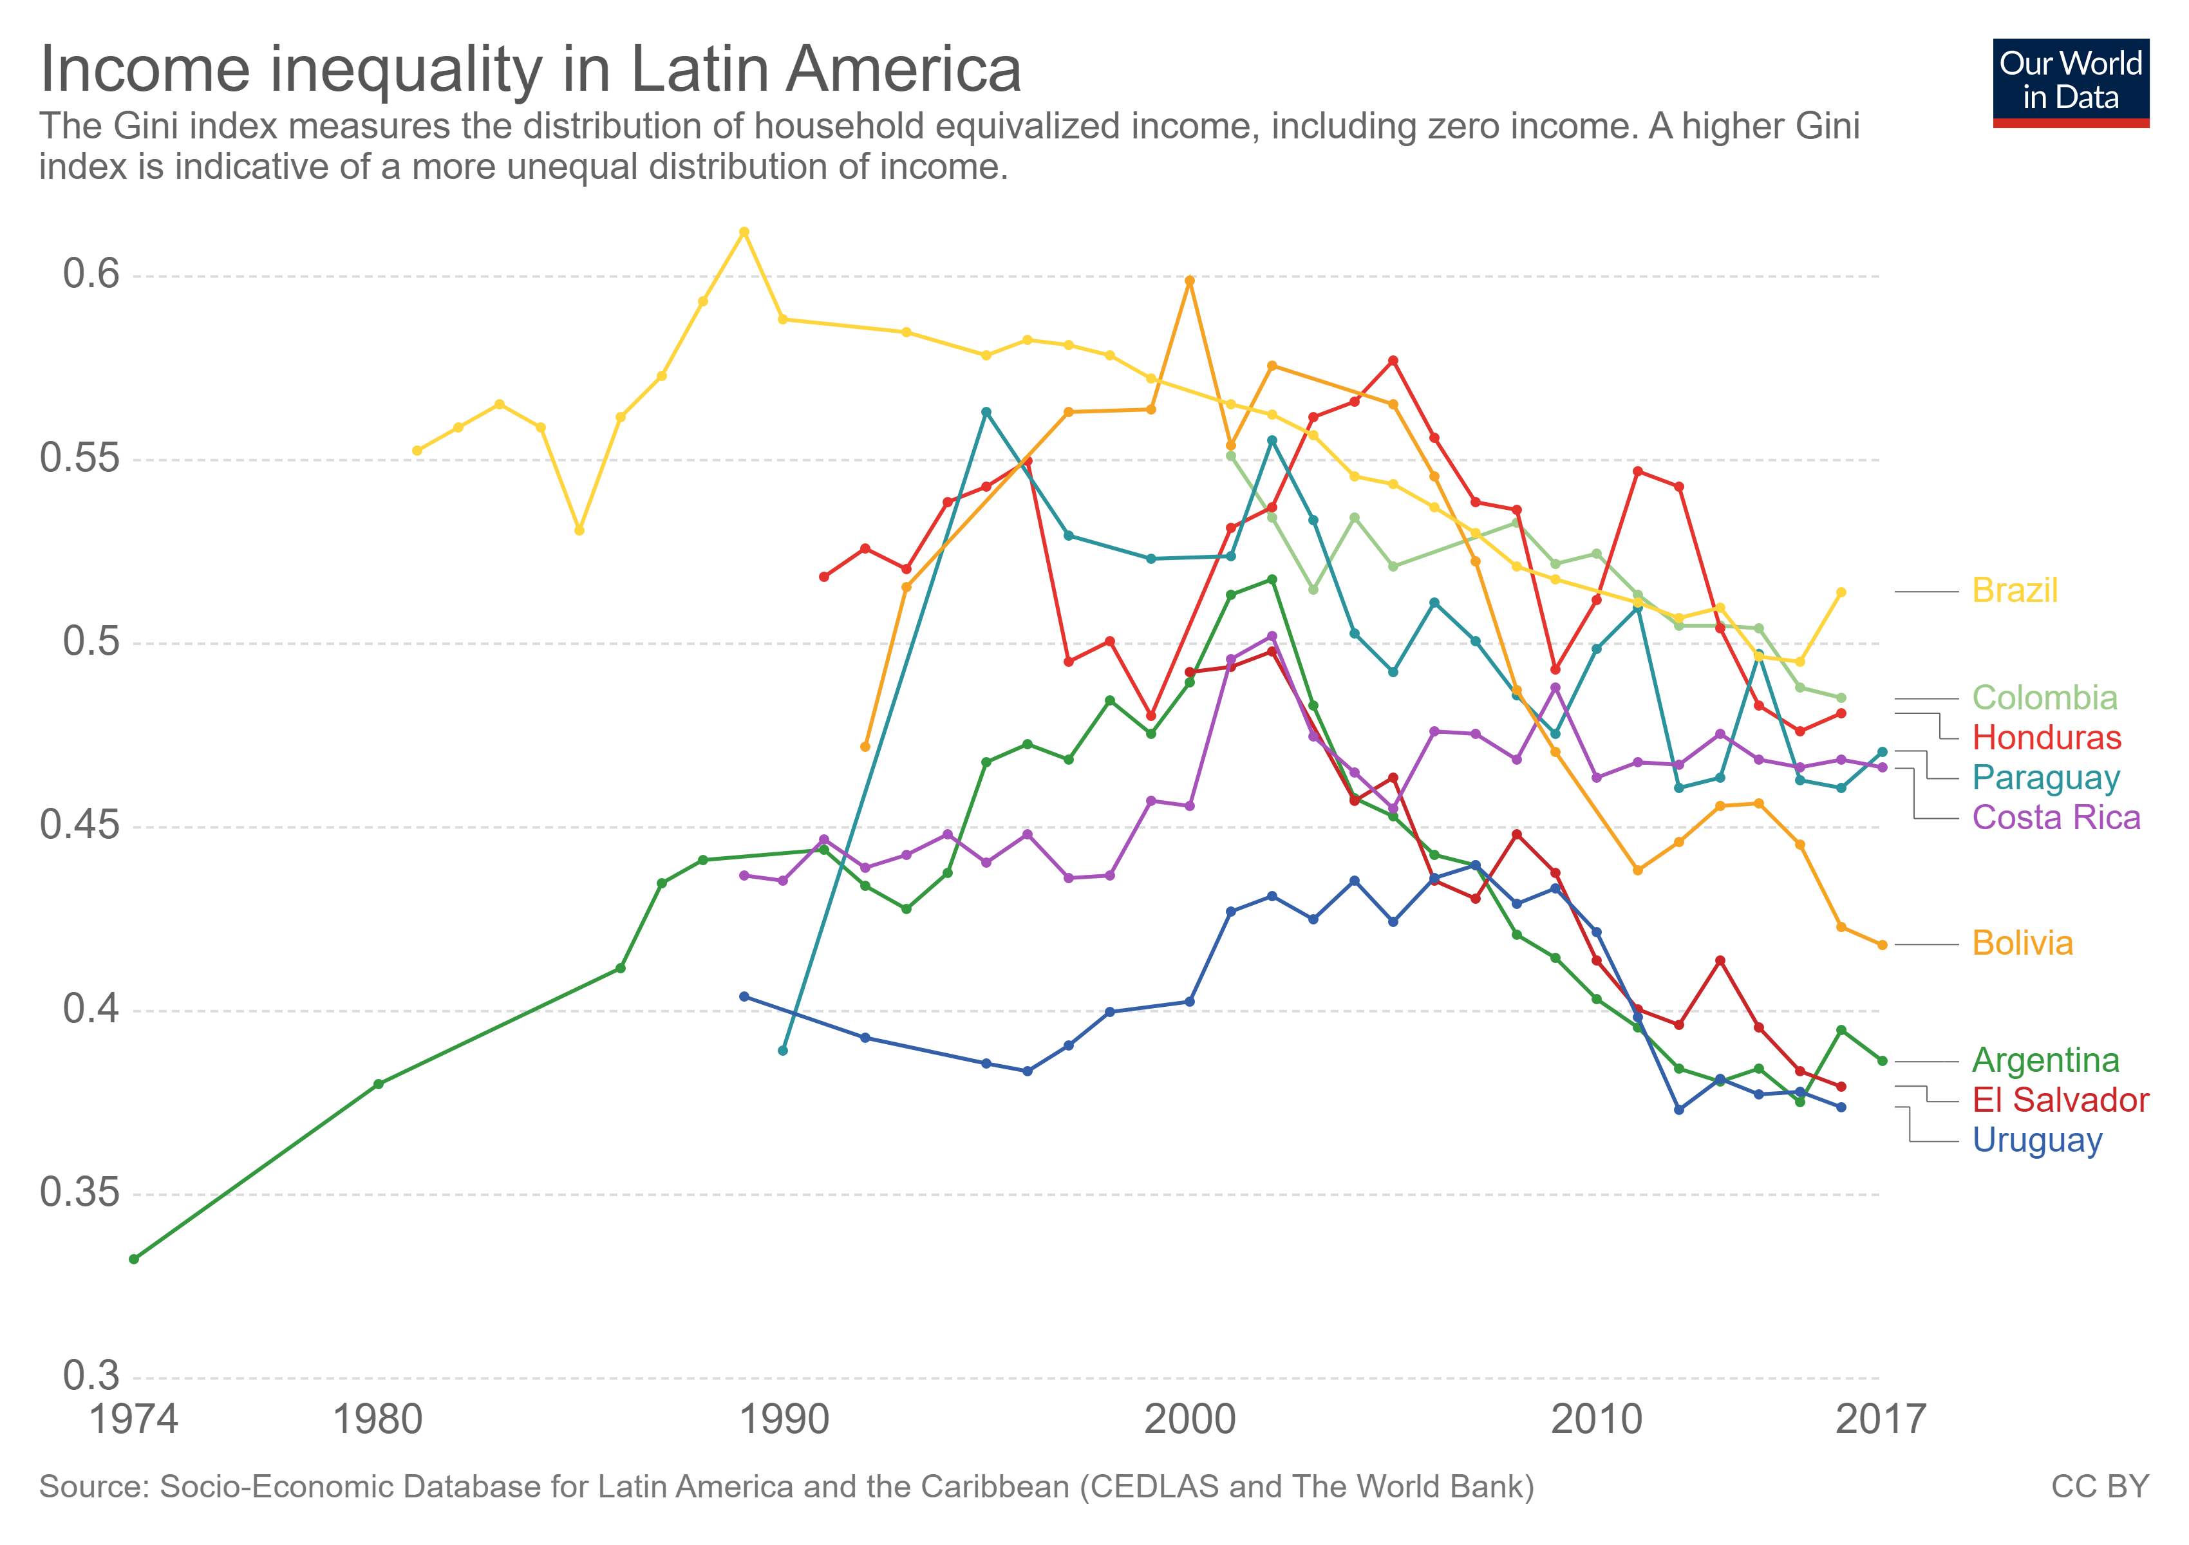
SINCE THE MID-1990S STEEP DECLINE OF INCOME INEQUALITY IN LATIN AMERICA

Slide 9
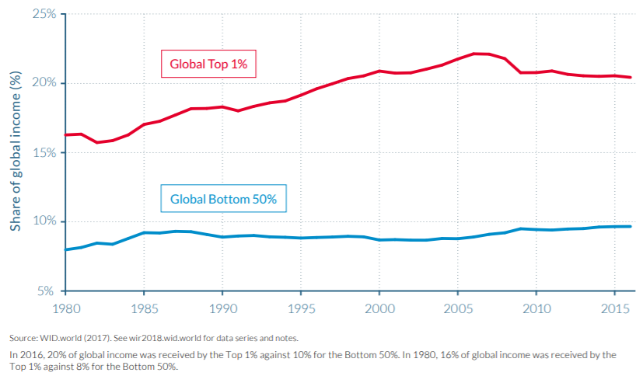
HOW CAN WE MEASURE INEQUALITY BETTER?
Income at the top of the distribution is systematically under reported
Source: World Inequality Report, 2018

Slide 10
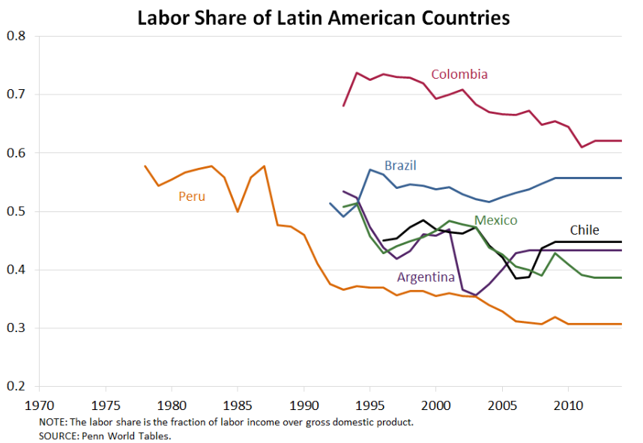
WHAT ABOUT INEQUALITY BETWEEN FACTORS OF PRODUCTION?
Labour’s declining share
Source: World Inequality Report, 2018

Slide 11
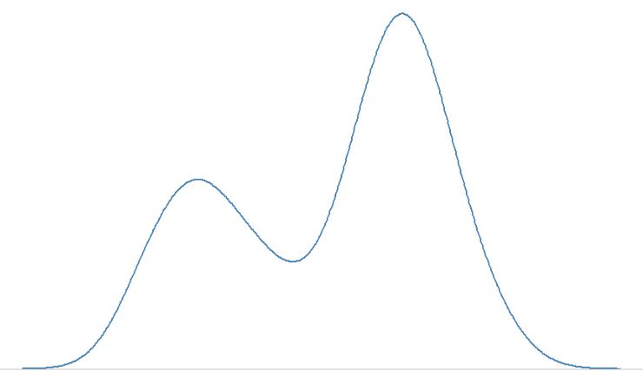
INEQUALITY
AND
MIDDLE CLASSES
Density
Distinguishing between polarization and inequality
Income

Slide 12
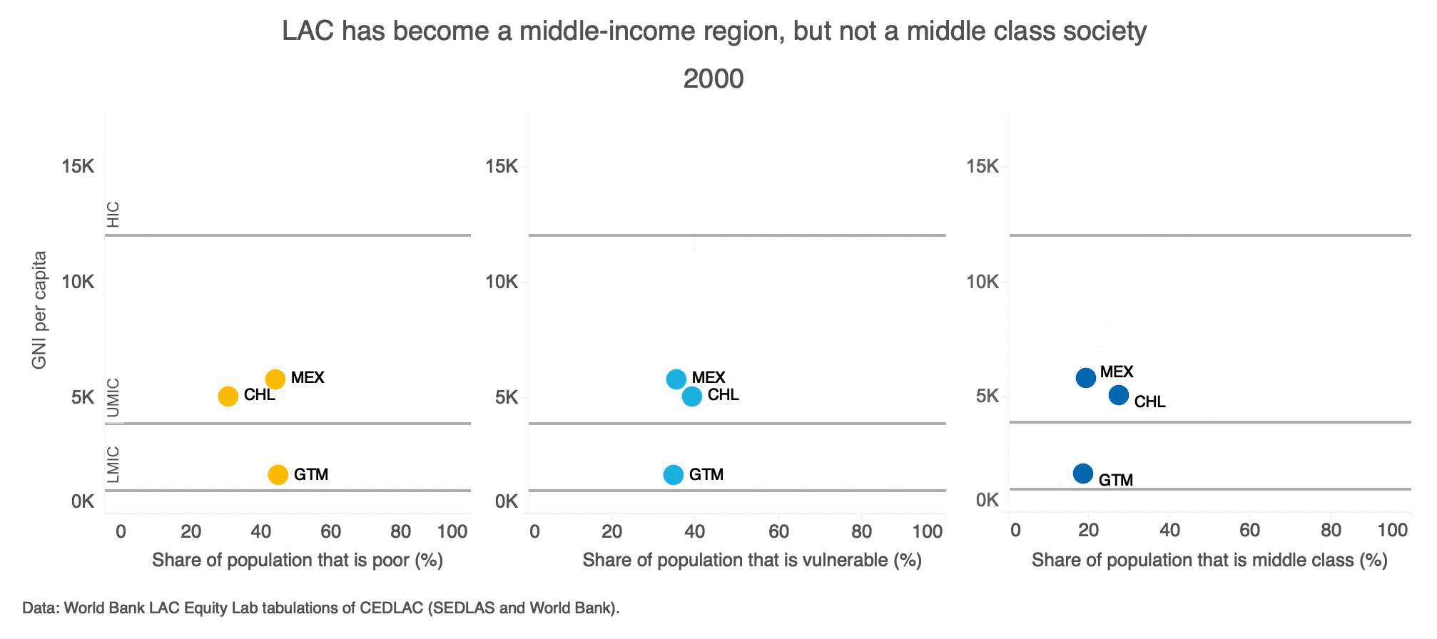

Slide 13
As of 2018, 90% of Brazilians and 88% of Mexicans believe that their country is governed to protect the interest of a few powerful groups
PEOPLE THINK THE SYSTEM IS UNFAIR…
Brazil (90%)
Mexico (88%)
LAC (79%)
The share of people who believe that their country is governed to protect the interest of a few powerful group is rising
Share of population
Uruguay (65%)
Source: Latinobarometro

Slide 14
Effective Governance is a pre-condition for development
The Rule of Lax Index
1970
Asia
Africa
Caribbean
Europe
Latin America
North America
Source: VDEM
2015
“In establishing the rule of law, the first five centuries are always the hardest” —GORDON BROWN
Notes:
The Rule of Law index by Varieties of Democracy is a measure of the the impersonal application of the law, and the extent to which the law is applied to rulers.

Slide 15
INEQUALITY AND THE EFFECTIVENESS OF GOVERNANCE: AN INFINITY LOOP
Power Asymmetries
De Jure Power
De Facto Power
Rules
Policy
Arena
Development Outcomes
-Growth
-Inequality
RULES
GAME
OUTCOME GAME

Slide 16
INEQUALITY AND UNDERDEVELOPMENT TRAPS
Unequal structure
Rent-seeking, big business
Corporatist unions
Inefficient market functioning
Slow and inequitable growth
Distorted policy design
Weak institutions
Source: The Inequality Trap and its Links to Low Growth in Mexico (Guerrero, Lopez-Calva, Walton, 2006)

