Slide 1
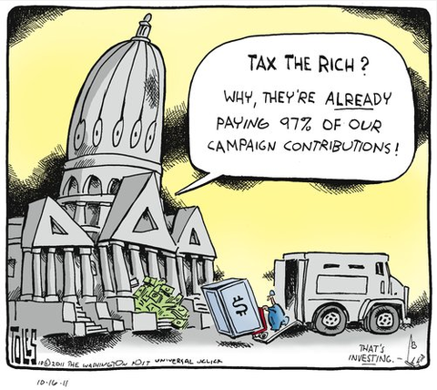
Affluence and Congruence Unequal Representation Around the World
Noam Lupu
Vanderbilt University
Zach Warner
Cardiff University
Notre Dame
April 8, 2019

Slide 2
Democracy and representation
Do elected representatives reflect the preferences of citizens?
Pro-rich bias in the U.S. – assumed to be driven by campaign finance
Is the U.S. exceptional?
If not, why is there a bias?

Slide 3
What is representation?
Responsiveness
vs.
Congruence
Dyadic representation
vs.
Collective representation

Slide 4
How would we know?
Ideal: compare mass preferences and outcomes on all policies
Gilens comes closest
Bartels compares median voter ideology to Senator NOMINATE
Not available comparatively
Compare elite and mass survey responses
Elite responses correlate with behavior (esp. unconstrained)
Congruence itself matters

Slide 5
Data
Every available legislator/candidate survey with left-right ideology question
Match to mass survey in the same country-year
90,000 elite observations, 3.9 million mass observations
563 country-years across 52 countries / 30 years
Mostly Europe and Latin America

Slide 6
Aggregate analysis
Construct mass-elite dyads
99 million observations, 3.9 million random effects
Two alternatives
Drop random effects and use IWLS
Bootstrap estimates of uncertainty by taking 250 samples of 50K
EMD: Lupu, Selios, and Warner (2017)
Compute for mass quintile of affluence (material wealth, income, occupation)

Slide 7
Affluence bias
Notes:
17% closer to rich

Slide 8
Beyond left and right
Left-right measures collapse lots of issues
High rates of non-response to left-right questions
LAPOP-PELA data
Identical issue questions
2010, 2012, 2014 waves

Slide 9
Bias by issue area

Slide 10
What is the direction of the bias?

Slide 11
Summary of findings
Representation is biased on average
Direction seems to depend on issue
Rich on economic issues (right)
Poor on social issues (right)
Reasons for these biases are not well-understood
Structural variables (e.g., economic inequality, left government, unionization, political competition, globalization)
Class backgrounds
Vote choice

